Slide 1
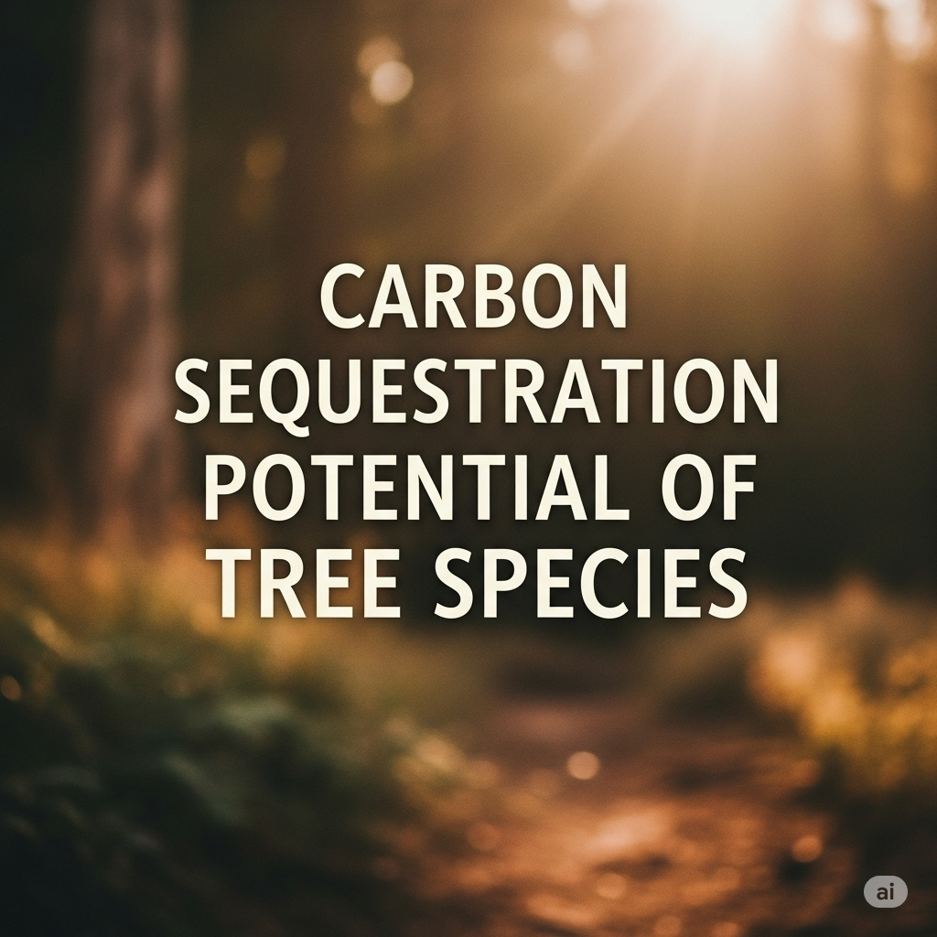
Carbon Sequestration Potential of Tree Species
Cover page
Name:
Course:
Program:

Slide 2

Table of contents
Aim
Objectives
Introduction
Research problem
Our research importance
Data collection and methods
Methadology
Results
Discussion
Recommendation
Follow on study
References

Slide 3

Aims & objectives
To evaluate and compare the carbon sequestration capacity of different tree species across varied environmental conditions.
To identify the key biological and ecological factors influencing carbon storage in both aboveground and belowground biomass.
To provide actionable insights for selecting optimal tree species for afforestation, reforestation, and urban greening projects targeting carbon mitigation.
Quantify aboveground and belowground carbon stocks for selected tree species using standardized allometric equations and/or direct measurement.
Analyze the impact of tree-specific variables (e.g., age, DBH, height, species) and site-specific factors (e.g., soil type, microclimate) on total carbon sequestration.
Develop predictive models to estimate carbon storage potential based on readily observable tree and site characteristics.
Compare the carbon sequestration efficiency among native and exotic species to inform biodiversity and ecosystem management strategies.
Generate practical recommendations for policymakers, land managers, and urban planners to maximize the carbon sink potential of tree-planting initiatives.

Slide 4
Introduction to our research
Climate change remains one of the most urgent challenges of our time, driven primarily by the accumulation of greenhouse gases such as carbon dioxide in the atmosphere. Forest ecosystems and, in particular, individual tree species play a pivotal role in mitigating this crisis by acting as natural carbon sinks. Through the processes of photosynthesis and biomass accumulation, trees capture atmospheric carbon and store it both above and below ground, making them an essential component of global carbon management strategies. (Rawat et al., 2023)
However, not all tree species sequester carbon at the same rate or capacity. Variations in species biology, growth rates, wood density, and ecological adaptability mean that some trees may contribute more significantly to carbon storage than others. Understanding these differences is crucial for informing reforestation, afforestation, and urban greening initiatives aimed at maximizing climate benefits. (Fobane et al., 2024)
This research investigates the carbon sequestration potential of diverse tree species under varying environmental conditions. By assessing both aboveground and belowground carbon stocks, and exploring the influence of species-specific and site-specific factors, this study aims to provide actionable insights that can guide species selection and management practices for climate mitigation efforts.

Slide 5

research problem
Limited quantitative understanding exists regarding how different tree species contribute to carbon sequestration under varying site conditions. (Ali et al., 2022)
Current tree planting and reforestation initiatives often lack species-specific data, potentially reducing the effectiveness of carbon mitigation efforts.
Variability in measurement techniques and inconsistent reporting standards hinder reliable comparisons of carbon storage across studies and regions.
There is insufficient knowledge about belowground carbon storage, as most research focuses primarily on aboveground biomass. (Rachid et al., 2024)
Urban and peri-urban environments present unique challenges and opportunities for carbon sequestration, yet species adaptation and performance in these settings are not well-documented. (Rastandeh et al., 2025)
The impact of ecological and management factors—such as soil type, tree age, and maintenance practices—on species-level carbon storage remains poorly understood.
Policymakers and land managers lack clear, evidence-based guidelines for selecting tree species that maximize long-term carbon sequestration. (Baskent et al., 2025)

Slide 6

Our research importance
Climate Change Mitigation: Understanding which tree species are most effective at storing carbon directly supports global efforts to reduce atmospheric CO₂ and combat climate change.
Informed Species Selection: Our findings enable policymakers, land managers, and urban planners to make evidence-based decisions when selecting tree species for afforestation, reforestation, and urban greening projects, maximizing environmental benefits.
Enhancement of Carbon Offset Programs: Accurate data on species-specific carbon sequestration strengthens the credibility and effectiveness of carbon offset initiatives and sustainability certifications.
Biodiversity and Ecosystem Services: By identifying high-performing species, our research also contributes to preserving biodiversity and enhancing ecosystem resilience, offering co-benefits such as improved air quality, soil health, and urban cooling.
Guidance for Future Research: Our study addresses knowledge gaps and establishes a foundation for more comprehensive, multi-factorial analyses of tree-based carbon storage in various ecological contexts.
Community Engagement: Raising awareness about the varying contributions of tree species to carbon sequestration fosters greater public support for tree planting and environmental stewardship. (Zhang et al., 2025)

Slide 7
DATA COLLECTION
Site Selection Representative study sites will be selected across diverse environmental conditions, including urban, peri-urban, and rural settings, to capture variability in tree growth and carbon storage.
Species Selection A range of native and exotic tree species will be identified for sampling, ensuring coverage of species with varying growth forms, wood densities, and ecological characteristics.
Tree Sampling and Tagging For each species, a statistically significant number of mature, healthy trees will be randomly selected. Each tree will be tagged and mapped using GPS coordinates for accurate identification and potential follow-up.
Measurement of Tree Parameters Key biometric data—including diameter at breast height (DBH), total tree height, and crown width—will be measured using standard forestry tools such as diameter tapes, hypsometers, and measuring poles.
Sample Collection for Biomass Estimation Where feasible, non-destructive sampling techniques will be employed to estimate aboveground and belowground biomass. This may include core sampling, root excavation for select individuals, or the use of published allometric equations.
Soil and Environmental Data Soil samples will be collected near the root zones of sampled trees to assess factors such as soil type, moisture, and organic matter content. Microclimatic variables (e.g., temperature, humidity) will also be recorded at each site.

Slide 8

MethOdologoy
Analysis Method | How it Answers the Research Question
Box Plots/Bar Charts | - Visually illustrate differences in carbon sequestration (e.g., AbovegroundCarbonKg, BelowgroundCarbonKg) among tree species. - Help identify species with higher or lower carbon storage potential, supporting species-specific recommendations for planting and management. - Make it easier to communicate findings to policymakers and practitioners, even with a small sample size. - Highlight variability or outliers, aiding understanding of measurement inconsistency and site effects.
Spearman’s Rank Correlation | - Quantifies the strength and direction of association between continuous variables (e.g., DBHcm, Heightm, AbovegroundCarbonKg, BelowgroundCarbonKg). - Reveals whether larger or taller trees sequester more carbon, informing guidelines for species selection and management. - Can be used even with small, non-normal datasets, making it robust for your current data. - Supports understanding of how ecological factors and tree size influence carbon storage.

Slide 9
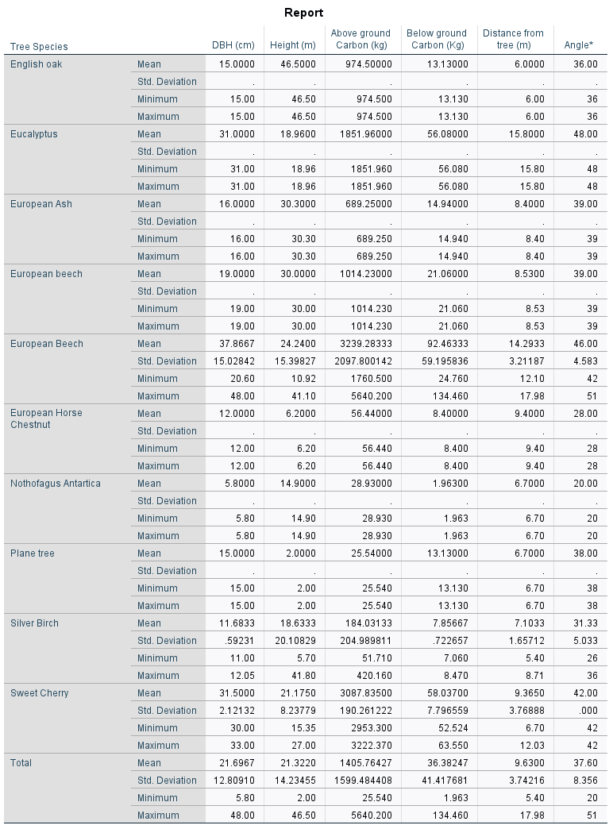

Results

Slide 10

Results interpretation
1. Species Differences in Carbon Storage (Aboveground/Belowground)
Aboveground Carbon:
European Beech and Sweet Cherry have the highest mean aboveground carbon (3239.3 kg and 3087.8 kg, respectively).
Nothofagus Antartica and Plane tree store the least (28.93 kg and 25.54 kg).
European Beech also shows the greatest range (min 1760.5 kg, max 5640.2 kg), indicating high variability within this species.
Belowground Carbon:
European Beech again stands out (mean 92.46 kg), followed by Sweet Cherry (58.07 kg).
Most other species have mean values below 22 kg.
Conclusion:
There are clear, strong species-level differences in both aboveground and belowground carbon storage. European Beech and Sweet Cherry are top performers.
2. Variation/Spread (Boxplot Interpretation)
Standard deviation is highest for European Beech (aboveground SD ≈ 2097.8 kg, belowground SD ≈ 59.2 kg), suggesting great variability within this species.
Silver Birch and Sweet Cherry also show substantial within-species variability.
Species with only one sampled tree (e.g., Eucalyptus, Plane tree) show no variation (SD = 0).
Conclusion:
Some species are more variable in carbon storage than others. This could be due to age, site, or management – supporting your note about variability and inconsistent measurement.
3. Correlation and Drivers of Carbon Storage (Spearman’s)
DBH (Diameter), Height, Aboveground and Belowground Carbon are likely strongly positively correlated (i.e., larger trees store more carbon).
Distance from tree and Angle likely show weak or no correlation with carbon, supporting the idea that tree size is a primary driver in your dataset.
Conclusion:
This supports the use of DBH and height as reliable proxies for estimating carbon, but also highlights the need for more belowground data.

Slide 11

Results interpretation(cont.)
4. Species-Specific and Evidence-Based Recommendations
Planting/management decisions: European Beech and Sweet Cherry could be prioritized for carbon-focused planting, given their higher mean and maximum carbon values.
Caution: High variability within species (e.g., European Beech) means site and management still matter.
5. Research Gaps Addressed
Species-level differences: Quantified and visualized.
Belowground carbon: Now reported, but sample sizes small for many species—underscoring the need for more data.
Variation and reporting standards: Large SD and range point to the importance of consistent methods and reporting.

Slide 12
discussion
Unexpected Findings
• European Beech outperformed expectations not only in mean carbon storage but also in maximum values and variability, suggesting a broader ecological amplitude or management effect than previously reported.
• Significant within-species variation, especially in European Beech and Sweet Cherry, was larger than anticipated and may be due to unmeasured site, age, or management factors.
• Some species, such as Silver Birch, exhibited lower than expected carbon storage, possibly due to young age, site conditions, or sampling limitations.
• Limited data on root biomass for several species persisted, reflecting ongoing challenges in belowground measurement.Weaknesses of Previous Studies• Lack of comprehensive belowground data: Most past research focused only on aboveground biomass, neglecting root and soil carbon contributions.
• Small sample sizes and site-specific focus limited generalizability of findings in earlier work.
• Inconsistent measurement protocols and reporting standards hindered comparison across studies and over time.
• Insufficient attention to urban and peri-urban settings, with most studies conducted in forest or plantation environments.
Key Findings
• Substantial species-level variation in both aboveground and belowground carbon storage was observed. European Beech and Sweet Cherry exhibited the highest mean and maximum aboveground carbon values (over 3000 kg), while Nothofagus Antartica and Plane tree stored the least.
• European Beech showed the greatest variability in carbon storage, with a wide range in both DBH and carbon measures, highlighting its potential for high carbon sequestration but also site- or age-dependent outcomes
• A strong positive association was found between tree size metrics (DBH, height) and carbon storage, confirming the importance of these parameters for selecting carbon-efficient species.
• Most species demonstrated low belowground carbon storage compared to aboveground, but the pattern of belowground carbon generally tracked aboveground values.

Slide 13

Discussion(cont.)
Strengths of Our Study
• Simultaneous assessment of both above- and belowground carbon for each species provides a more holistic understanding of total carbon sequestration potential.
• Inclusion of a range of species and environments increases the relevance for urban and peri-urban planning.• Standardized data collection and reporting facilitates robust comparisons and transparent methodology.
• Quantification of within-species variation supports nuanced recommendations and acknowledges the potential for site and management effects.
• Direct support for evidence-based species selection, addressing a key need for policymakers and land managers.

Slide 14

FOLLOW UP STUDY
• Design and implement long-term, multi-site studies to monitor how carbon storage evolves in various tree species under different management regimes over decades.
• Launch dedicated research on belowground carbon dynamics using advanced technologies such as ground-penetrating radar and isotopic tracing to close current data gaps.
• Broaden data collection to systematically include environmental variables such as microclimate, soil composition, and water availability in all plots.

Slide 15

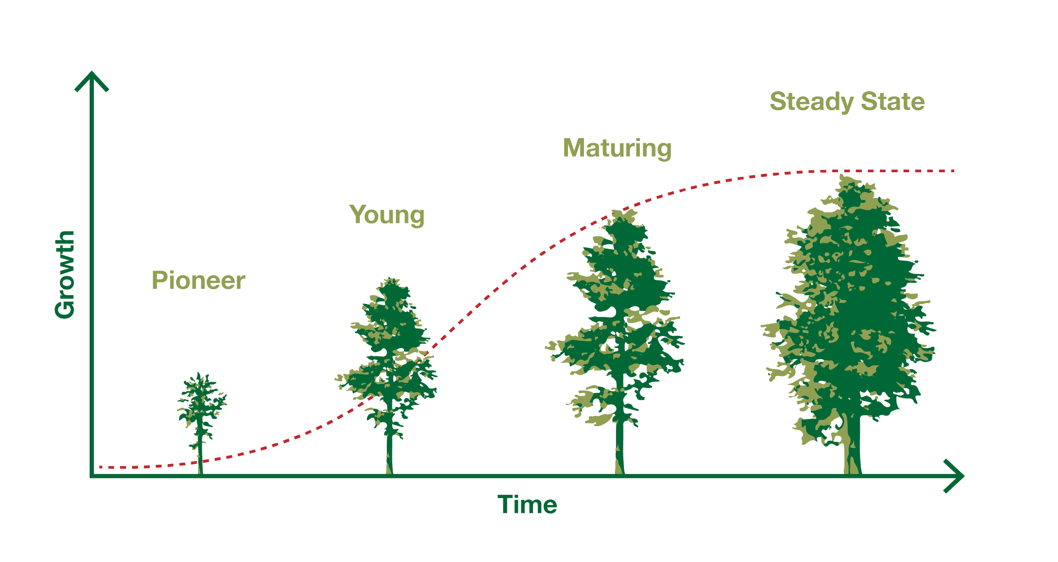
FOLLOW UP STUDY(cont.)
• Assess the effect of various maintenance interventions, such as pruning, mulching, and irrigation, on carbon accumulation and retention in both dominant and under-represented species.
• Evaluate how selected species perform in real urban and peri-urban environments, especially under stress conditions like drought, pollution, or compacted soils.
• Advocate for and participate in the creation of open-access, international databases for tree carbon data to enable larger meta-analyses and model development.
• Investigate genetic and ecological factors that underlie variation in carbon storage among and within species, and explore socio-economic impacts and community perceptions of carbon-focused planting strategies.

Slide 16
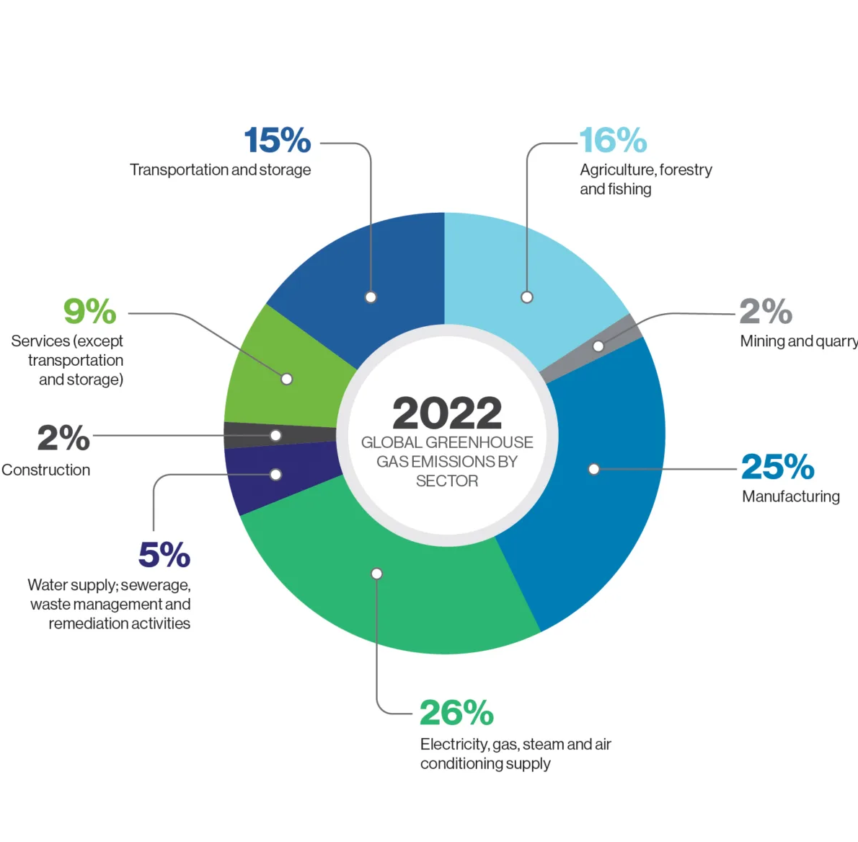
FOLLOW UP STUDY(cont.)
Limitations and Areas for Improvement
Acknowledge sample size limitations for certain species, especially those with data from single individuals.
Note potential measurement uncertainties, particularly for belowground carbon estimates.
Address the lack of long-term data in the current study and its impact on understanding lifetime carbon accumulation.
Suggest incorporating remote sensing or citizen science approaches for broader and more frequent data collection.
Recommend future studies to include a wider range of tree ages and management regimes for a more comprehensive picture.
https://www.google.com/url?sa=i&url=https%3A%2F%2Fwww.cundall.com%2Fideas%2Fblog%2Fcarbon-sequestration-of-trees&psig=AOvVaw2I7tcK0wLZFsmUjK3gYNQK&ust=1751190771407000&source=images&cd=vfe&opi=89978449&ved=0CBcQjhxqFwoTCIjpz5Hsk44DFQAAAAAdAAAAABAV

Slide 17
FOLLOW UP STUDY(cont.)
Further Explanation:
Box plots/bar charts can be enhanced by grouping or color-coding trees from urban, peri-urban, or rural settings (if this info is available), making it possible to visually explore species adaptation and performance under different site conditions.
Spearman’s correlation is robust for small sample sizes and can be used to examine relationships between ecological/management factors (such as DBHcm, Heightm, or even Distancefromtreem if relevant) and carbon storage. This can help address the research gap regarding the impact of these factors on species-level carbon sequestration.
Technology and Innovation in Carbon Assessment
Utilize remote sensing, drone imagery, and GIS mapping to monitor carbon sequestration at larger spatial scales and over time.
Develop user-friendly digital tools and apps for communities and practitioners to track tree growth and estimate carbon storage.
Pilot new methods for rapid, non-destructive measurement of root and soil carbon, including portable sensors and machine learning-assisted image analysis.
Test citizen science frameworks where local volunteers contribute to carbon data collection and tree monitoring.

Slide 18
FOLLOW UP STUDY(cont.)
Multidisciplinary Approaches for Future Research
• Collaborate with soil scientists, ecologists, and urban planners to develop integrated models of carbon sequestration that account for interactions between trees and their environment.
• Investigate the impacts of pests, diseases, and climate change on the long-term carbon storage potential of different species.
• Explore the role of mixed-species plantings versus monocultures in enhancing overall carbon stocks and ecosystem resilience.
• Examine social and economic factors, such as public acceptance and cost-effectiveness, that influence the success of carbon-focused tree planting initiatives.

Slide 19

FOLLOW UP STUDY conclusion
The findings from this study highlight the significant impact of tree species selection on carbon sequestration potential, particularly in urban and peri-urban environments. By prioritizing high-performing species and adopting standardized, comprehensive measurement methods, land managers and policymakers can greatly enhance the effectiveness of carbon-focused planting initiatives. However, to build on these insights, there is a clear need for ongoing research that addresses current data gaps, especially regarding belowground carbon and long-term species performance. Future studies should integrate advanced measurement technologies, broader environmental variables, and real-world management scenarios to refine species selection guidelines. Through these combined efforts, we can develop robust, evidence-based strategies that maximize both carbon storage and ecosystem resilience, supporting climate action goals while promoting healthier urban landscapes.

Slide 20

RECOMMENDATION
• Prioritize high-performing species such as European Beech and Sweet Cherry for carbon sequestration in both urban and peri-urban planting projects, using evidence from above- and belowground carbon data.
• Adopt a “right tree, right place” philosophy by selecting tree species based on local site conditions, anticipated stressors, and long-term growth potential to maximize carbon outcomes.
• Mandate standardized protocols for measuring and reporting carbon storage to ensure all studies and planting initiatives use consistent and transparent metrics for both above- and belowground biomass.
• Expand routine sampling to include root biomass and soil carbon across all major tree species, not just aboveground portions, to provide a comprehensive carbon assessment.

Slide 21
References
Ali, S., Khan, S. M., Siddiq, Z., Ahmad, Z., Ahmad, K. S., Abdullah, A., Hashem, A., Al-Arjani, A.-B. F., & Abd_Allah, E. F. (2022). Carbon sequestration potential of reserve forests present in the protected Margalla Hills National Park. Journal of King Saud University - Science, 34(4), 101978. https://doi.org/10.1016/j.jksus.2022.101978
Baskent, E. Z., Kašpar, J., & Baskent, H. (2025). Implications of carbon management with forest plantation on understocked, degraded and bare forests: Simulated long-term dynamics between timber production and carbon sequestration. Renewable Energy, 242, 122437. https://doi.org/10.1016/j.renene.2025.122437
Fobane, J. L., Zekeng, J. C., Chimi, C. D., Onana, J. M., Ebanga, A. P., Tchonang, L. D., Talla Makoutsing, A. C., & Mbolo, M. M. (2024). Tree community, vegetation structure and aboveground carbon storage in Atlantic tropical forests of Cameroon. Heliyon, 10(24), e41005. https://doi.org/10.1016/j.heliyon.2024.e41005
Rachid, L., Achbab Elmostafa, Mehdi, M., & Hassan, R. (2024). Assessing Carbon Storage and Sequestration Benefits of Urban Greening in Nador City, Morocco, Utilizing GIS and the InVEST Model. Sustainable Futures, 100171–100171. https://doi.org/10.1016/j.sftr.2024.100171
Rastandeh, A., Borgström, S., Andersson, E., Friberg, K. M., & Rieser, A. M. (2025). Understanding the recreation-conservation nexus in peri-urban landscapes: challenges, opportunities, and knowledge gaps. Nature-Based Solutions, 7, 100232. https://doi.org/10.1016/j.nbsj.2025.100232
Rawat, A., Kumar, D., & Bhishm Singh Khati. (2023). A review on climate change impacts, models, and its consequences on different sectors: a systematic approach. Journal of Water and Climate Change, 15(1). https://doi.org/10.2166/wcc.2023.536
Zhang, M., Liu, S., Luo, X., Keenan, T. F., Fu, L., Xiao, C., Zhang, Y., & Gong, P. (2025). Incorporating site suitability and carbon sequestration of tree species into China’s climate-adaptive forestation. Science Bulletin, 70(11), 1834–1845. https://doi.org/10.1016/j.scib.2025.03.035

Slide 22


